Slide 1


Slide 2




Meet the Team
Maddalena Romano
Esteban
Doyle
Karissa Listrand
Analytics and Performance
Public Realm
Public Realm
LEARNING SUMMIT 2025

Slide 3

Background
ArcPro Method
ArcPro Results
ArcPro Limitations
Next Steps
Python Method
Python Results

Slide 4
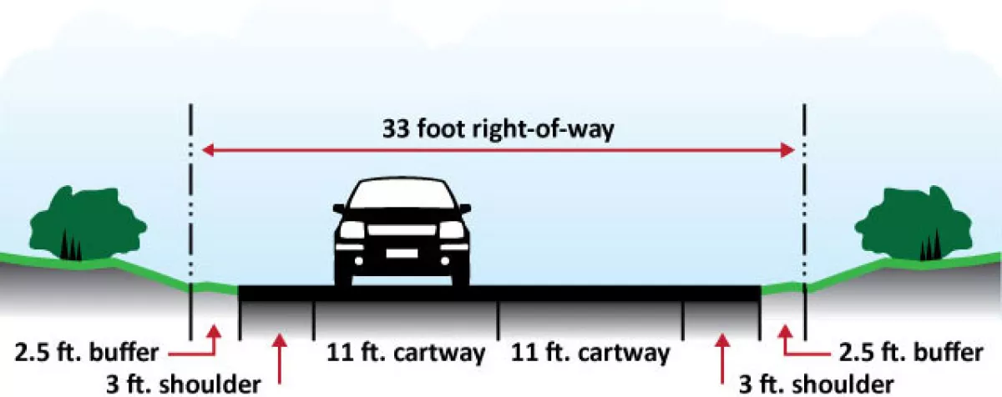
What is Right of Way?
Strip of land used for public passage and transportation
Include sidewalks, drainage, medians, landscaping, utilities
Public easement or owned property
“Right-of-Way Line" is boundary bet public/private property

Slide 5
Why Do This Project?
Accurate Sidewalk and Street ROW width crucial for planning/design, and can benefit DOT/other agencies
Identify locations to prioritize
Curb extensions, sidewalk extensions, plazas, shared streets
Advocate for policy changes
Prioritize sidewalk space for pedestrians
Previous data is outdated and contains errors and inconsistencies
LEARNING SUMMIT 2025

Slide 6


Roadbed
Sidewalk
LION
MapPLUTO
Building Footprints
LEARNING SUMMIT 2025

Slide 7
ArcPro Method
Sidewalk
Collapse Polygon
Generate Transects
Clip to Sidewalks
Sidewalk
Roadbed
Collapse Polygon
Generate Transects
Clip to Sidewalks
Roadbed
Nodes
Buffer LION Nodes
Remove Nodes
Node
LION
Buffer LION
Remove Highways, Streets
LION
LEARNING SUMMIT 2025

Slide 8
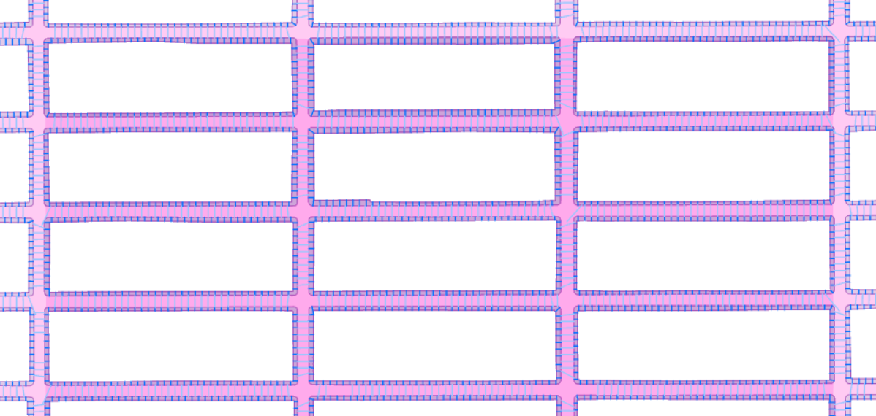
ArcPro Results
LEARNING SUMMIT 2025

Slide 9

So Why Not Use ArcPro?
Spatial joins produce errors
Directionality of transects
Directionality of attributes
Dependency on ArcPro

Slide 10


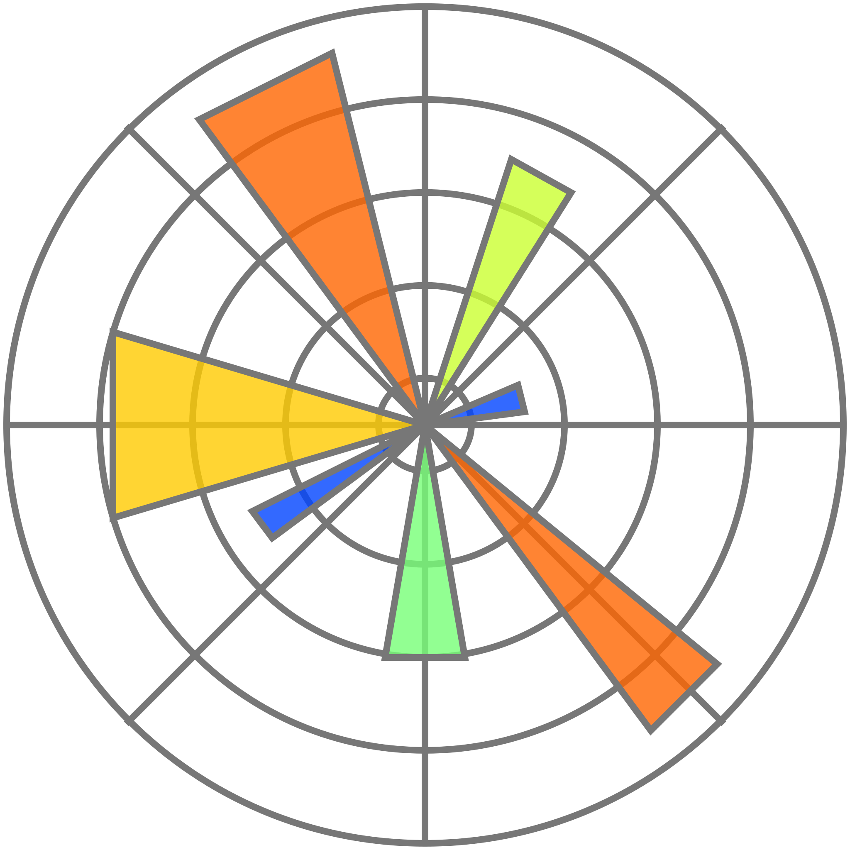
Why Python?
GeoPandas: Idiomatic vector GIS operations using GDAL / Fiona / Shapely
Shapely: Modern, robust geometry for clipping transects to polygon edges
Fiona: Stable read / write of Shapefile / GeoPackage formats
Matplotlib: Lightweight map previews
Notes:
GeoPandas: idiomatic vector GIS operations (read/write, CRS handling, vectorized ops) using GDAL/Fiona/Shapely under the hood.
Shapely ≥ 2.0: modern, robust geometry predicates/ops (buffer, clip, intersection, line interpolation). Crucial for clipping transects to polygon edges.
Fiona (via GeoPandas I/O): stable read/write of Shapefile/GeoPackage formats.
Matplotlib: lightweight map previews for QA (no heavy styling required).
A GeoPackage is an open, standards-based format that stores vector features, raster maps, and tile caches within a single, lightweight SQLite database file. It is particularly useful for mobile devices and offline workflows because it consolidates multiple datasets into one file, making it easy to transfer and use across different platforms and software. The format is maintained by the Open Geospatial Consortium (OGC).
GDAL is a translator library for raster and vector geospatial data formats that is released under an MIT style Open Source License by the Open Source Geospatial Foundation. As a library, it presents a single raster abstract data model and single vector abstract data model to the calling application for all supported formats. It also comes with a variety of useful command line utilities for data translation and processing.
A coordinate reference system (CRS) is a framework for defining the location of points on Earth using coordinates.

Slide 11
Python Method (High Level)
Load Roadbed and Sidewalk data Project to EPSG:2263 (feet) for distance math
Calculate centerline using min. bounding box long axis
Sample points every 20 ft along the centerline
Build perpendicular raw transects
Clip transects to polygon edges
Export Roadbed and Sidewalk transects
LEARNING SUMMIT 2025
Notes:
This notebook builds “tape‑measure” transects across each Right‑of‑Way (ROW) polygon (roadbeds and sidewalks). For each polygon, we create a fast, stable proxy centerline from the polygon’s oriented minimum bounding rectangle, sample points along it, emit perpendicular lines, and clip those lines exactly to the polygon edges so each transect spans boundary‑to‑boundary. The result is a defensible set of width measurements at regular intervals.
EPSG Geodetic Parameter Dataset (also EPSG registry) is a public registry of geodetic datums, spatial reference systems, Earth ellipsoids, coordinate transformations and related units of measurement, originated by a member of the European Petroleum Survey Group (EPSG) in 1985
2253 - NAD83 / New York Long Island (ftUS)
An oriented minimum bounding box (OMBB) is the smallest-area rectangle that encloses a set of points or a geometric object, which is rotated to fit the object's orientation more tightly than an axis-aligned bounding box (AABB). This orientation makes the OMBB more accurate for tasks like collision detection and space representation, particularly for irregularly shaped objects or when dealing with assemblies.

Slide 12

Python Method (Detail)
Import Data
Setup
Export Data
Run Pipeline
Import Libraries
Map
Build Pipeline
Add Utilities
Build Transects
Geometry Setup
Notes:
1) Environment setup
Create and activate a conda environment with the geospatial stack (run in a terminal, not in this notebook):
conda create -n row python=3.11 geopandas shapely fiona rtree -c conda-forge conda activate row
rtree is optional but speeds up spatial operations.
2) Inputs
Shapefiles (polygons):
Roadbed_... .shp
SIDEWALK_... .shp
Recommended CRS: EPSG:2263 (US feet). The script will set/convert to 2263 if needed.
3) Key parameters
Exactly what this cell does:
Defines input paths and output locations.
Sets spacing (interval) between transects and the half‑length (reach) of raw perpendiculars before clipping.
Configures sampling for quick iteration, Shapefile export toggle, and the target CRS in feet.
4) Imports & Setup
Exactly what this cell does:
Imports core libraries.
Sets up Matplotlib inline plotting (for QA).
Does not alter global styles; plots are intentionally simple.
5) Utility Helpers
Exactly what this cell does:
Provides safe file deletion helpers to clear previous exports (especially Shapefile sidecars) so you don’t get stale/locked files on re-runs.
6) Geometry Foundations
Exactly what this cell does:
Builds a straight‑line centerline proxy from the polygon’s minimum rotated rectangle (longest edge).
Samples points along that centerline at a fixed interval.
Computes a unit tangent at each sample and rotates it 90° to get a perpendicular (normal).
Creates a long raw transect for each sample and clips it to the polygon boundaries so endpoints lie on the edges (or to the longest interior piece if boundary intersections are messy).
7) Build Transects
Exactly what this cell does:
For a single polygon, computes the centerline, samples points at the configured interval, creates perpendiculars, and clips them.
Returns (centerline, [clipped_transects...]).
8) Pipeline
Exactly what this cell does:
Read roadbed/sidewalk shapefiles (via GeoPandas/Fiona).
Ensure CRS is EPSG:2263 (feet) for consistent distance math.
Optionally sample first N features for quick iteration.
Loop over polygons and build centerlines/transects (handling MultiPolygons).
Assemble GeoDataFrames for export and return them.
9) Run the Pipeline
Exactly what this cell does:
Executes the process with your parameters.
Prints basic counts to confirm output density.
If counts look low, check CRS and increase *_REACH_FT.
10) Exports
Exactly what this cell does:
Writes a clean GeoPackage with four layers.
Optionally clears and writes Shapefiles for compatibility.
11) Visualization for QA
Exactly what this cell does:
Produces a quick two‑panel plot showing centerlines (bold) and transects (thin) for roadbeds and sidewalks.
For large datasets, keep SAMPLE_LIMIT small to render quickly.

Slide 13

Let’s Check Out the Jupyter Notebook
LEARNING SUMMIT 2025

Slide 14
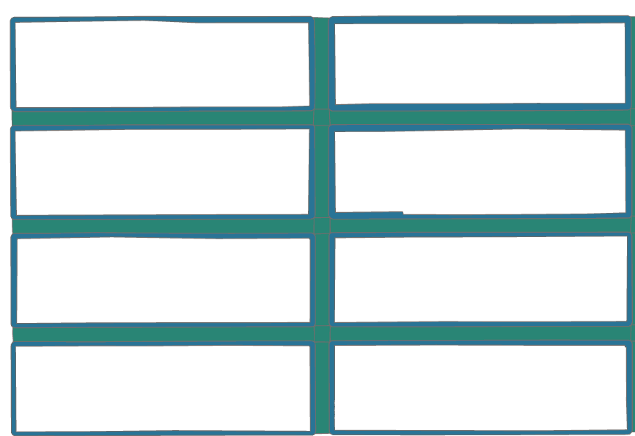
Python Results
LEARNING SUMMIT 2025

Slide 15
Add attributes
Street name
Street Segment ID
Left/Right Blockface ID
Street Width Right-Of-Way
And so on

Slide 16

Maddalena Romano
mromano1@dot.nyc.gov
github.com/mromano1/Street-Width-ROW
LEARNING SUMMIT 2025

Slide 17


